Slide 1
Predicting Sarcasm in Reddit Comments
Joe Poirier, Amy Ryu, Joshua Toth

Slide 2

Dataset: “Sarcasm on Reddit”
1.3 Million sarcastic comments from Reddit.com.
Comments with the “/s” tag are labelled as sarcastic.
Balanced training dataset: ~ 500K sarcastic, serious comments
Dataset also includes parent comments associated with each comment and seven other fields of metadata, including author name, comment score, and date and time of posting
https://www.kaggle.com/datasets/danofer/sarcasm

Slide 3
Project Overview
Implement four BERT training and fine-tuning regimens and evaluate performance against baseline.
Look for the degree to which unfreezing layers (encoder layers) in BERT helps improve performance.
Evaluate the successes and pitfalls of each model i.e. how does classification accuracy vary by comment length.

Slide 4
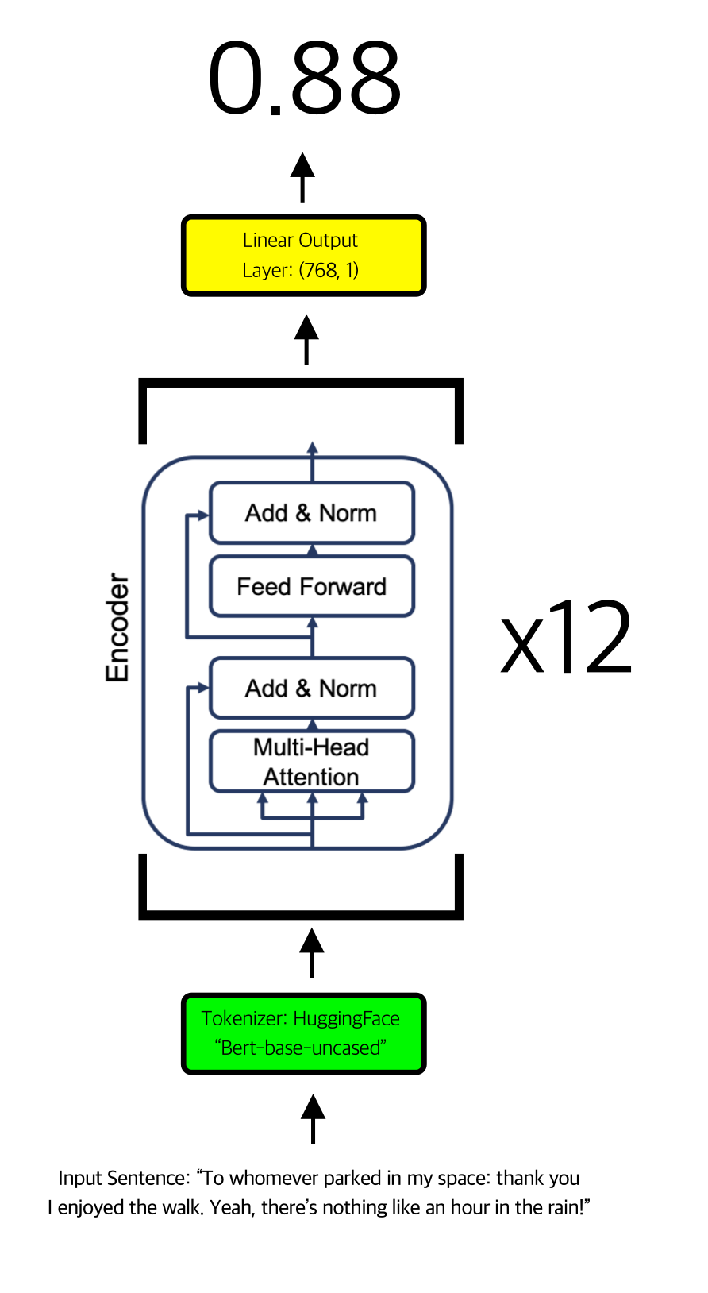
About: BERT-Base Model
Pre-trained natural language sentiment model.
Twelve encoder layers, featuring twelve multi-head attention (MHA) units with twelve heads each.
Pretrained tokenizer and linear output layer used.

Slide 5
Preprocessing & EDA (BERT Models)
Only comment text and label used. Null comments and comments with fewer than 20 words were omitted from the dataset.
Shorter sentences can be unreliable and depend more heavily on unseen context:
“1571049” (Serious)
“Noted.” (Serious)
“Exactly, no reason whatsoever.” (Sarcastic)
Data were split into two dataframes by label and re-zipped together. Ensures balanced minibatches.

Slide 6
Adaptive Dataloading
Problem: using normal balanced dataloading, models are learning to predict all comments as serious.
Solution: adaptive dataloading —
• after each training batch, calculate the false positive and false negative rates.
• find the ratio of false positives over total errors, and use that to determine the label distribution (if 65% of errors are false positives, 65% of labels in the next batch will be negatives).
• output a variable-label-distribution batch by loading from an all-negative and an all-positive dataloader and combining data into a mixed batch.

Slide 7
Training Procedure
Optimizer, Adam with learning rate of 1e-5, beta_1 = 0.9, beta_2 = 0.999, epsilon = 1e-7.
Run 10 epochs of 25 batches * 32 text samples from the balanced dataset.
Five models trained:
Vanilla BERT finetune: only linear output layer is finetuned
Vanilla BERT finetune, with adaptive dataloader
BERT finetune, with two encoder layers unfrozen.
BERT finetune, with four encoder layers unfrozen.
Full BERT retrain (all 12 encoders and input layers unfrozen).
Evaluation: 256-item test set, using training accuracy. Also, 32-item evaluation every five epochs.

Slide 8
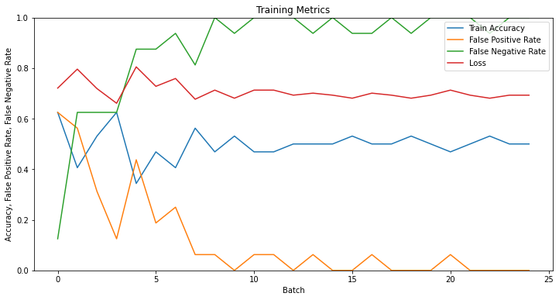
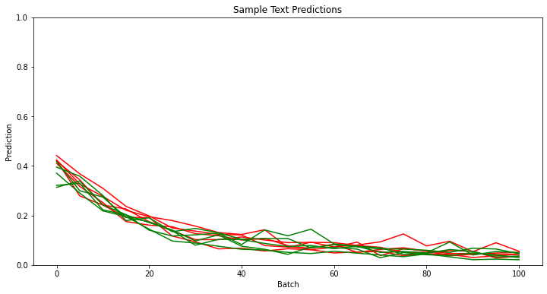
1. Results, Vanilla BERT Finetune
Accuracy: 49.61% (>20 Word Comments) 50.00% (All Comments)
False Positive Rate: 50.00%
False Negative Rate: 0.39%
Notes: I only trained this model and model 2 for 30 epochs at the longest, since they were both demonstrating strong signs of convergence.
Regardless of initialization (one iteration started with sample text predictions close to 1.0), predictions will invariably devolve towards zero.

Slide 9
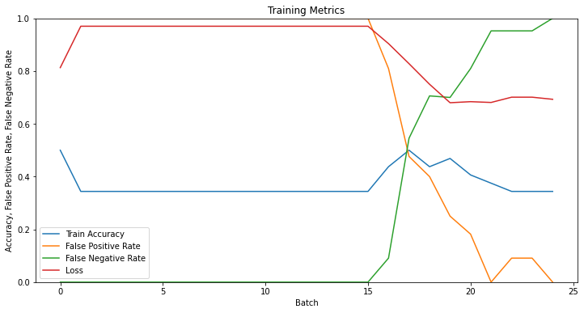
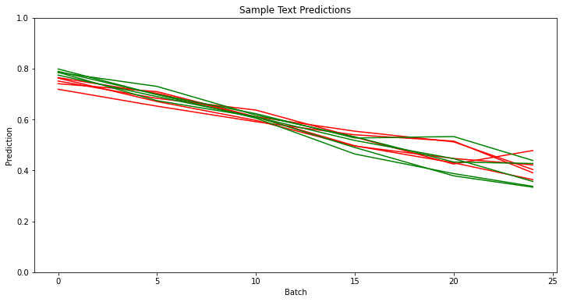
2. Results, BERT Finetune with Adaptive Dataloader
Accuracy: 49.61% (>20 Word Comments) 64.02% (All Comments)
False Positive Rate: 1.17%
False Negative Rate: 49.20%
Notes: while this run may not have been the perfect example, adaptive dataloading did consistently lead to sample text predictions around 50% and false positive/negative rates converging.
That said, the output-layer-only finetuning strategy appears to be a non-starter. Sarcasm prediction is too complex to be modeled using a simple linear pretrained BERT regression.

Slide 10
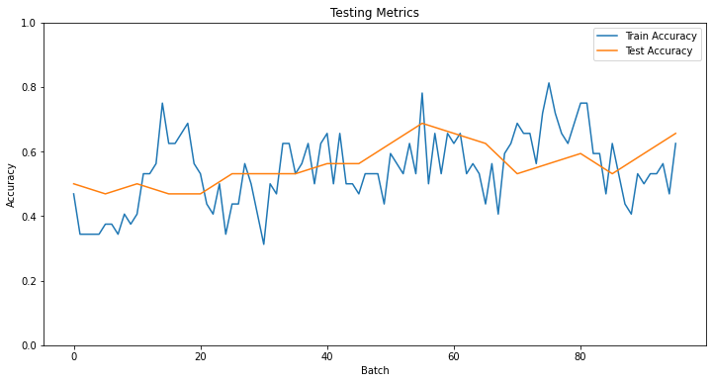
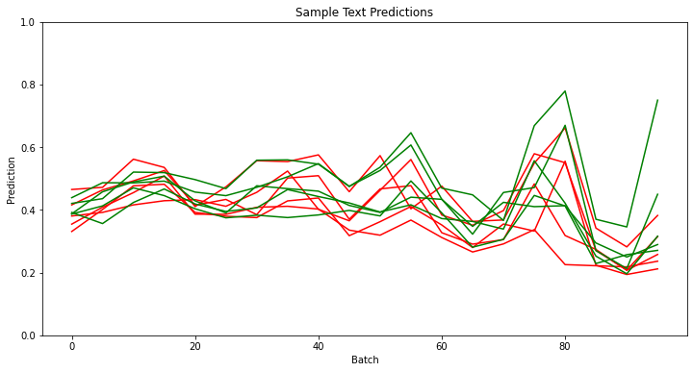
3. Results, BERT Finetune with Two Encoders Unfrozen
Accuracy: 67.50% (>20 Word Comments) 64.02% (All Comments)
False Positive Rate: 11.86%
False Negative Rate: 20.71%
Notes: this test set was unusually harsh, as two previous runs saw this model reaching >80% accuracy after 250 batches.
Surprisingly, the two-encoder model did just as well as the four-encoder model. It should be noted that this finding wasn’t consistent across trials, but the difference between unfreezing two and four encoders seems to have been fairly insignificant.

Slide 11
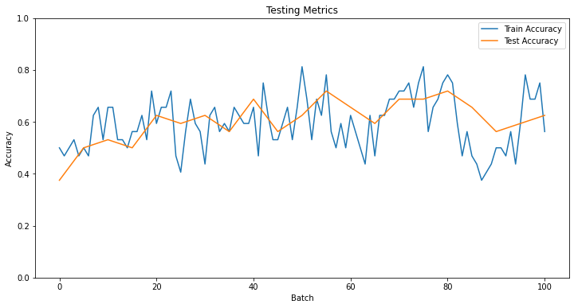
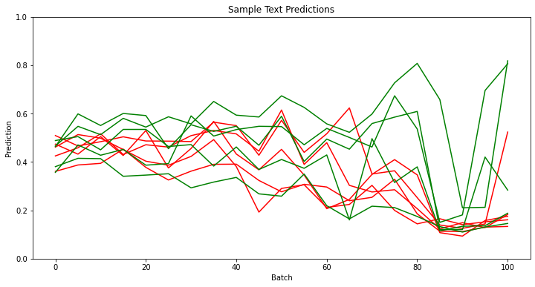
4. Results, BERT Finetune with Four Encoders Unfrozen
Accuracy: 67.43% (>20 Word Comments) 62.60% (All Comments)
False Positive Rate: 11.86%
False Negative Rate: 20.71%
Notes: this test set was unusually harsh, as two previous runs saw this model reaching >80% accuracy after 250 batches.
The model unsurprisingly took longer per-batch than model 3 and less than model 5. Accuracies are reported after 250 batches of training, though only 100 batches are shown here due to Colab RAM issues.

Slide 12
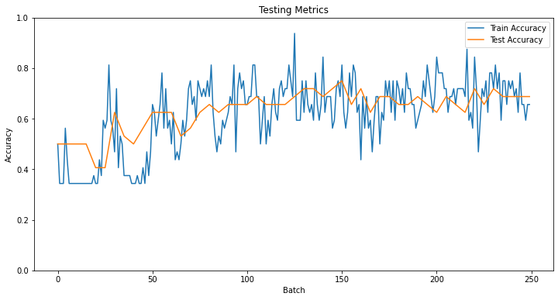
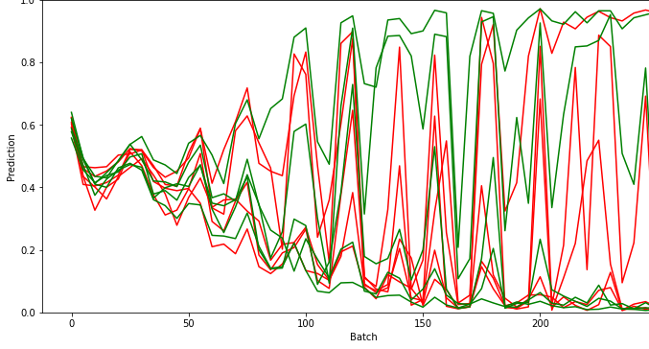
5. Results 12-Encoder BERT Fine-Tune
Accuracy: 74.98% (>20 Word Comments) 68.91% (All Comments)
False Positive Rate: 15.43%
False Negative Rate: 15.66%
Notes: this test set was unusually harsh, as two previous runs saw this model reaching >80% accuracy after 250 batches.
This model outperformed the partial-retrain model per-epoch; however, models 3,4,5 performed roughly the same on a per-time basis

Slide 13
Challenges
The greatest challenge was constant RAM issues on Colab. Especially in the full BERT retraining case (5), crashes happened more often than not.
Future solution: these models could be fine-tuned far more effectively (with far more data) via cloud computing.
Also, long-term storage of models (as checkpoints) would help greatly.
Another challenge: models will tend towards predicting all comments as serious, even when dataset is balanced.
Solution: the adaptive dataloader helped greatly to this end.

